Slide 1
Network (IDS/IPS

Slide 2
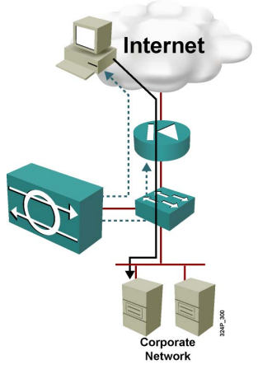
IDS (Intrusion Detection System)
Passive
Reactive
Optional Active

Slide 3
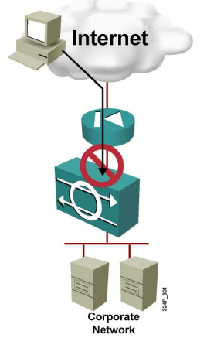
IPS (Intrusion Protection System)
Active
Proactive Prevention

Slide 4
Combining IDS & IPS
IPS Actively blocks offending traffic
Allowing legit data
Stops known malicious traffic
Requires well tuning for optimal connectivity
IDS Complements IPS
Verification
Alerts
Covers the grey area of malicious traffic

Slide 5
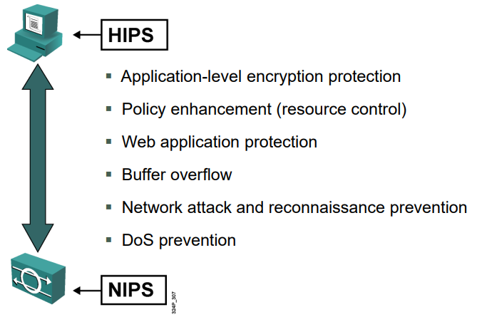
HIPS(Host based) & NIPS(Network based)

Slide 6
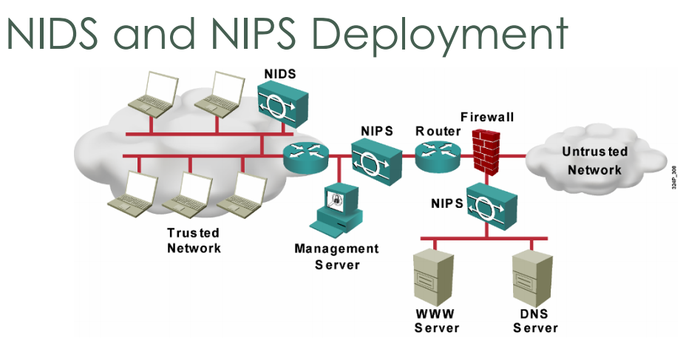
NIDS & NIPS

Slide 7
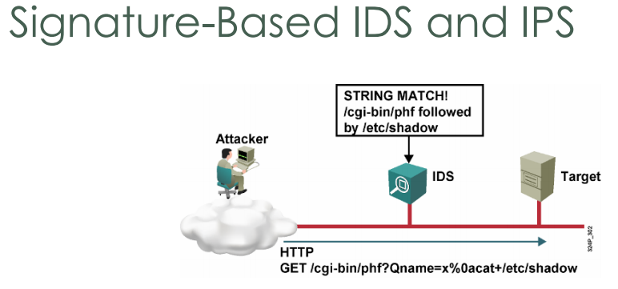
Signature-Based IDS + IPS

Slide 8
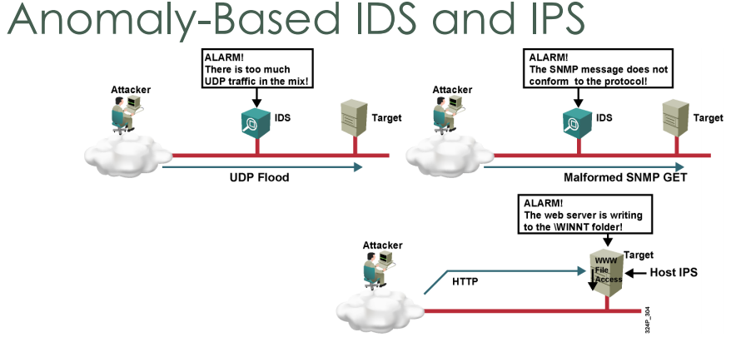
Anomaly-based IDS + IPS

Slide 9
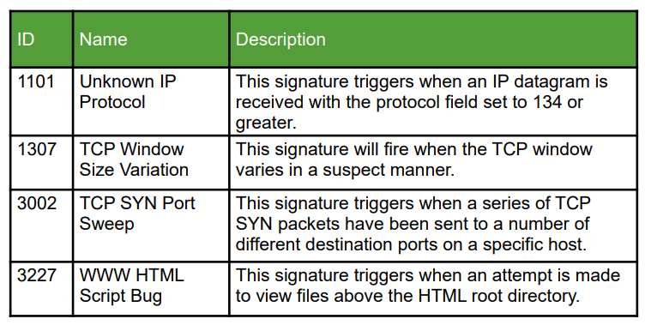
Signature Examples

Slide 10
Security Onion
IDS/IPS
Snort
Analasys
Squil

